Slide 1
A GDN Odyssey:
1997-2024 and beyond
Daniel Druckman

Slide 2
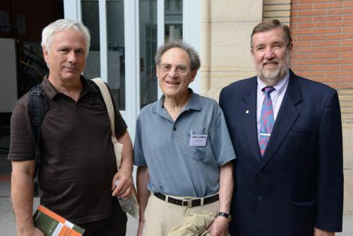
Movers and Shakers:
Gregory, Mel, and Keith

Slide 3
The Indefatigable Mel
The CCNY quarterback experience prepared him for a leadership role
Actively promoting his new Journal in the early 1990s
Worth having a look
Thought it provided an interesting alternative to existing Journals in the field, less on peace, more on formal modeling
Our comparative analysis project at IIASA in Austria was a good fit
Became a special issue in 1997
Led to continuing contributions suited to the GDN community

Slide 4
Dimensions of International Negotiation
My first appearance in GDN (vol 6, no 5, 1997)
A statistical search for dimensionality, a taxonomic analysis
MDS and discriminant analyses of 23 cases coded from interviews of delegates to arms control, trade, and environmental conferences
Amoeba-like diagram showing a clustering of cases by size: bilateral, small multilateral, large multilateral
Small vs large: less turnover of delegates, treaties more likely, less firm deadlines, more likely to be private
Our Austrian sponsors found these findings to be useful especially since, as a mid-range power, they are more likely to have influence in smaller forums

Slide 5
Fred Ikle’s Typology
My second GDN article (1999, vol 8)
An inductive and quantitative approach to developing typologies
Our MDS analyses focused on evaluating the validity of a well-know typology on negotiation proposed by Ikle in his 1964 book, How Nations Negotiate
Here are six amoeba shaped clusters each containing a type of negotiation: Three cheers for Ikle: his intuition is supported
Multilateral regime cases: a new type of negotiation on regime creation that surfaced in the 1980s, since Ikle wrote his book

Slide 6
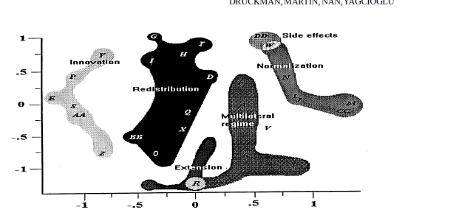
Ikle’s Amoebas

Slide 7
Value of Empirical Typologies
Past cases used to anticipate future cases of the same type
Distinguish processes and structures by type of objective
Identify new type of cases, or new islands
Islands of middle range theories induced from statistical analyses

Slide 8
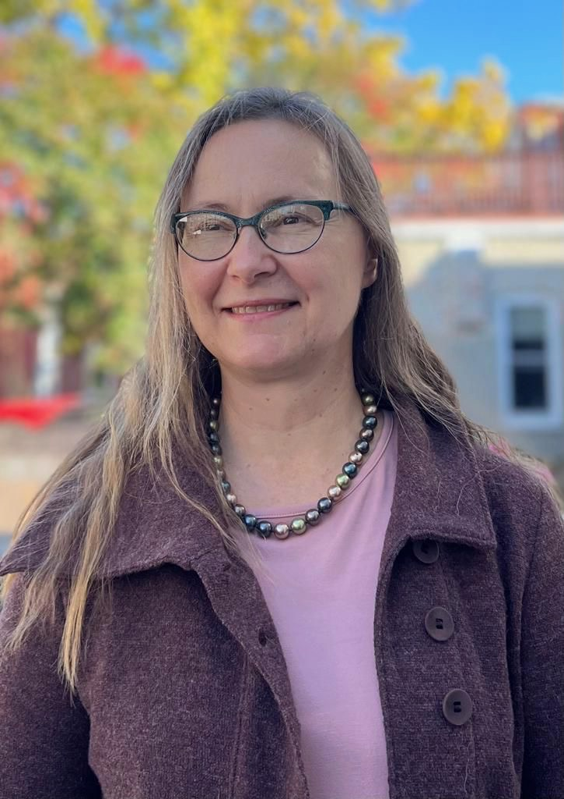
Susan Allen as collaborator

Slide 9
Negotiator Assistant
GDN articles
  2002, 11 (3): 231-256
  2004, 13 (6): 481-511
  2014 23 (2): 193-210
Issues, situation, process are highlighted
The flexibility grid as a diagnostic tool
Humans vs screens: agreements and integrative agreements
Does e mediation work? You bet ….

Slide 10
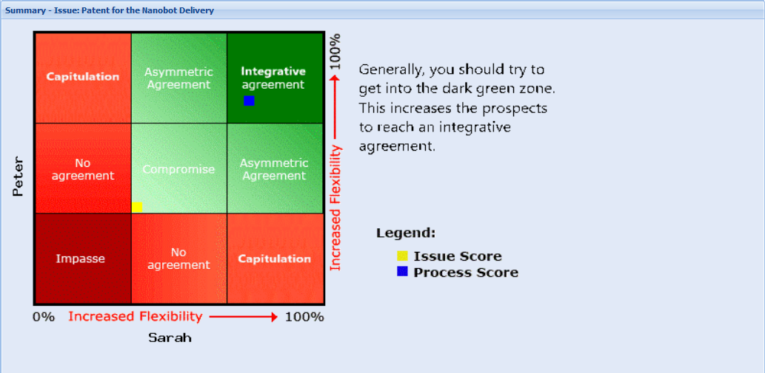
A Flexibility GRID

Slide 11
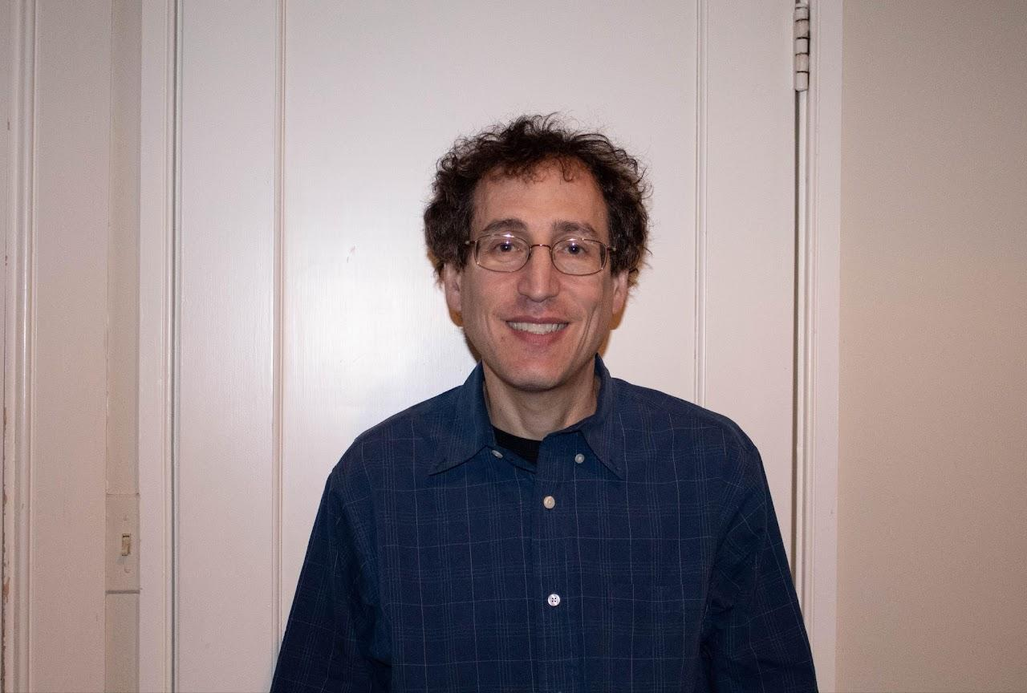
Jamie Druckman collaborator

Slide 12
Human and Screen Mediators
Experiment 1: The screen mediator produced more agreements than a reflection condition but was viewed less positively
Experiment 2: The screen mediator produced more agreements than an advice-only condition but was viewed less positively
Experiment 3: Two forms of e mediation (separate and joint) compared with a scripted human mediator
  Joint e mediation produced more agreements than both the human mediator and the separate e mediator
  The human mediator produced more integrative agreements than both e mediation conditions
  The human mediator was viewed more favorably than both e mediators

Slide 13
Take aways
Screen mediators are generally effective in getting to yes
The joint e mediation experience is more effective than separate e mediation
Alternatives – reflection, advice only, and human mediators – are viewed more favorably than screens
An animated, human-like e mediator may be perceived more favorably

Slide 14
Asynchronous Negotiation
Screen mediation (VienNA) in the Negoisst platform
Evaluating a set of hypotheses
Access to VienNA (vs a no mediation condition) produced:
  More flexibility in the bargaining process, especially when the system was used early in the process
  More concession reciprocation
  More messages dealing with relational issues
  More satisfaction with the process and outcome
  More balanced agreements when consulting advice on fairness norms

Slide 15
Robotic Mediation
Carlsburg Foundation grant to colleagues at Aarhus University
. A Telenoid robot, manufactured in Japan, was introduced in this experiment
Four conditions were compared: Screen (VienNA), Human, Robot, and a no mediation control; all mediators have the same scripting
254 dyads divided equally across the conditions participated in this technically complex experiment conducted in Aarhus Denmark
Scenario was a demerger of a pharmaceutical company; five issues divided the principals (Peter and Sarah)
The most important issue was ownership of the patent for developing new technologies for curing diseases
Two rounds of negotiation: Round one to impasse, break for mediation, round two to agreement or impasse. Average time of the experiment was two hours

Slide 16
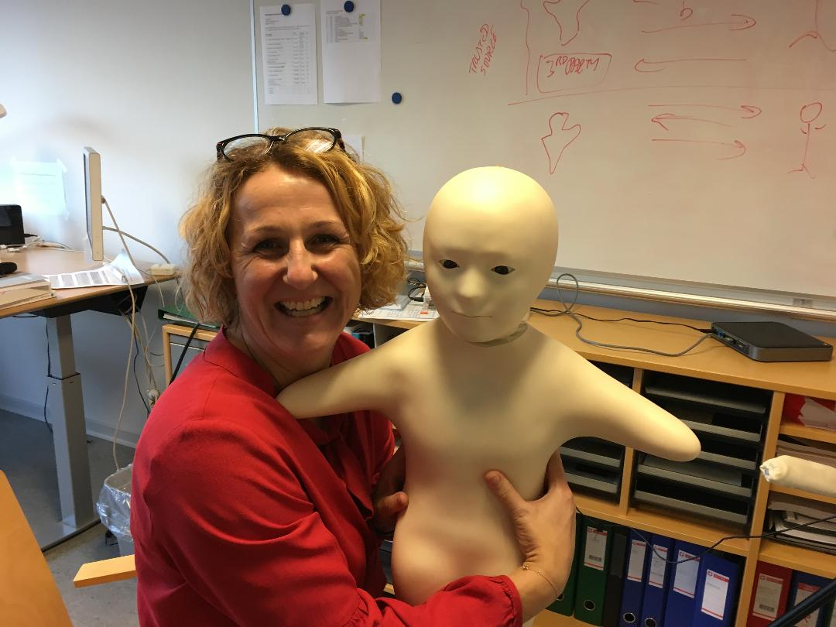
Sabine Koszegi with the Telenoid robot
🤗
🤗
🤗

Slide 17
Results
Robot mediators produced significantly more agreements than the human and control conditions
Robot mediators produced more agreements than the screen condition but the difference was not significant
Robot mediators produced significantly more integrative agreements, as a proportion of the total, than the other three conditions

Slide 18

Lin Adrian makes a critical observation

Slide 19
Lin’s insight
After coding and analyses Lin raised a question
She noticed that two types of agreements were included in the same category – integrative agreements
One type of agreement suggested a solution to the key issue of patents for inventions – it followed from the negotiation structure
Another type was novel (out of the box) not following the structure
We recoded the “integrative agreements” into these two categories
We then re-ran the analyses and the rest is history

Slide 20
Non-Standard Agreements
NSAs are inventive, out of the box, agreements that resolve the impasse by working around the structured alternatives
32% of all the agreements were NSAs
A significantly larger number of these agreements occurred in the Telenoid robot condition (50%)
Practically all of the integrative NSAs (83%) were in the Telenoid condition
Thus, robot mediators produced more NSAs and more integrative NSAs

Slide 21
Coding the Process
Searching for an explanation for the NSA results
Do creative outcomes (NSAs) develop from creative processes?
Coding the Round 2 (post mediation) negotiation conversations
Selected sessions in a focused comparison design (humans vs robots, integrative vs NSAs)
Three coding categories: Generating Ideas, Openness, Togetherness

Slide 22
Conclusions
Openness and Togetherness are better explanations than Generating Ideas
Social rather than cognitive processes are stimulated by the robot mediator
Why does this occur?
  Common fate (we are in this together)
  Novelty or surprise changes the interaction dynamic (more open to new ideas)
  A willingness to take risks with novel solutions (reaction to novel mediation)
  Experimental demand characteristic (guessing what they should do)

Slide 23
A Role for Emotions
2008 special issue on emotions
Adds warmth to a predominant emphasis on conversational processes and negotiation outcomes
Focuses on emotional intent inferred from verbal and nonverbal displays: coordination and strategy
Interplay between information processing and emotional expressions
Dynamics captured by Goffman’s concept of an expression game
Importance of organizational contexts for interpreting meaning

Slide 24
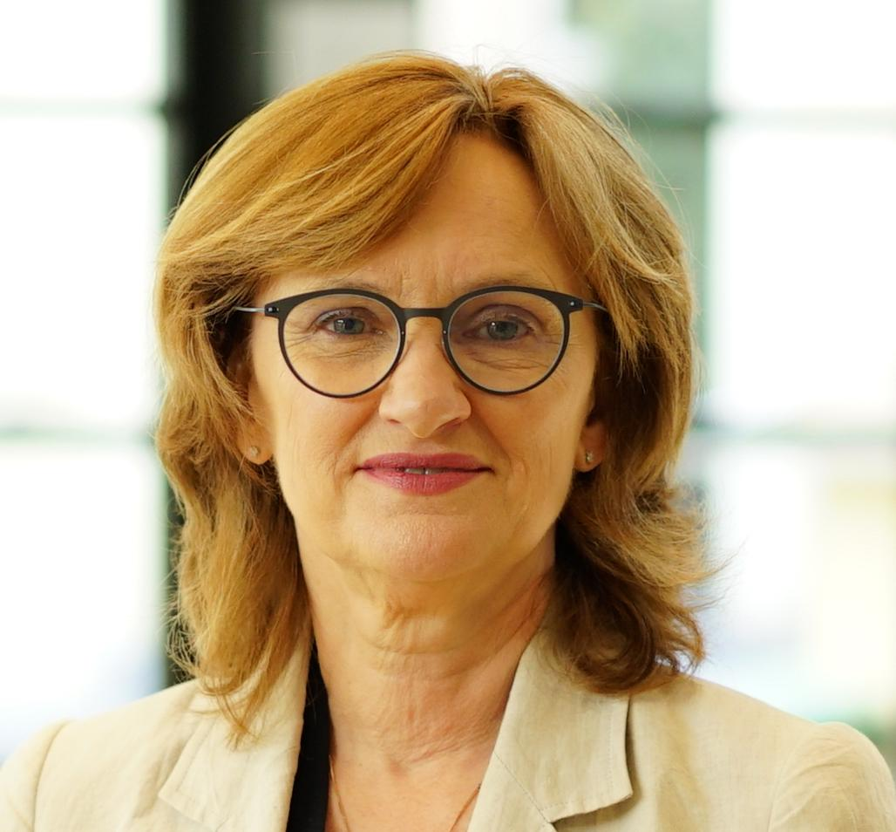
Mara Olekalns Collaborator

Slide 25
Justice Themes
Special issue on Justice and Fairness published in 2017
Takes a broad look at justice themes including psychological roots and political contexts
Psychological roots turn on the concept of perceived fairness where considerations of self esteem and moral commitment come into play
Contexts include marketplace transactions, civil war termination, bilateral territorial disputes, and multilateral international environmental negotiations
Types of justice studied include procedural (PJ), distributive, rule-based and transitional with an objective of securing a durable peace

Slide 26
Justice Themes (continued)
Hollander-Blumoff on the importance of courtesy and respect as drivers of procedural justice
Wagner and Druckman on the importance of stable agreements as mediators of PJ principles during the negotiation process and equal outcomes on durable peace
Welch on the importance of an inflamed sense of justice as a necessary condition for the onset of war
Albin and Druckman on the greater importance of PJ principles in multilateral than in bilateral talks in producing effective outcomes
Brams, Kilgour, and Klamler’s algorithm for determining an envy free Pareto optimal allocation that may apply across the above contexts

Slide 27
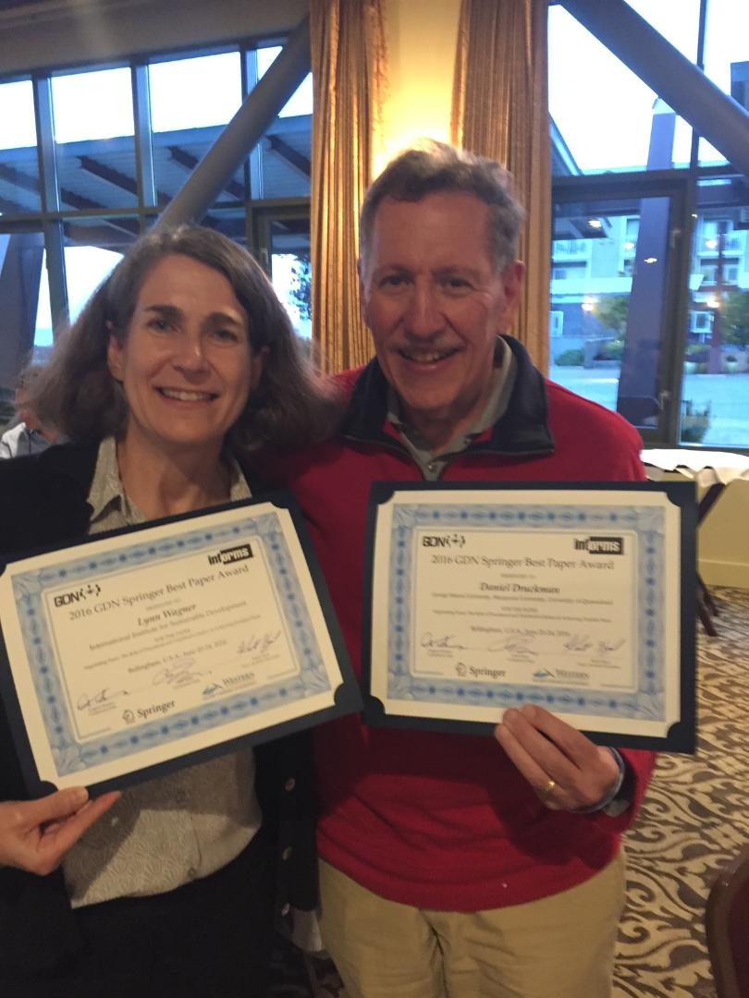
Lynn Wagner sharing a GDN best paper award on the justice research

Slide 28
To Match or Not to Match: That’s the Question
With Michele Griessmair 2018
Focus on noticing turning points (TPs) or departures when they occur
By manipulating the occurrence of a departure we can infer causation
Hypothesized that the framing of the negotiation matters
Two frames were cooperative-integrative and competitive-distributive
A cooperative-integrative increased attentiveness and led to matching of offers
The two-fold process of awareness and matching furthers understanding of the impact of TPs on agreements

Slide 29
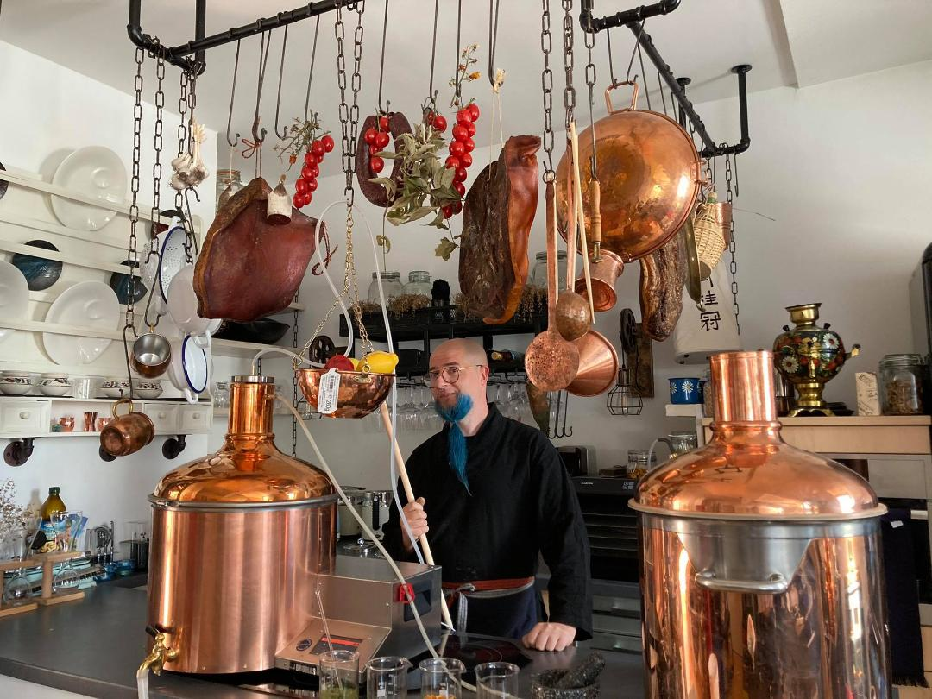
Michele Griessmair’s other passion: Brewing beer during the COVID lockdown

Slide 30
Values and Interests
With Fieke Harinck, 2019
Value conflicts are difficult to resolve
Many interventions have been tried with some effectiveness (role reversal, delinking from interests, pre-negotiation workshops)
A novel intervention is evaluated in this article: affirming the other by listing positive qualities
The intervention did produce better agreements with contingencies
The distinction between implicit (no sharing of the positive qualities) and explicit (sharing of the positive qualities)

Slide 31
Values and Interests (continued)
When mediation approaches are introduced we get interaction findings
Implicit affirmation worked best with a direct (and somewhat coercive) approach to mediation
Explicit affirmation worked best with a facilitative approach to mediation
These findings support predictions from Regulatory Fit theory (a fit between type of affirmation and mediation approach)
Both fits are explained by uncertainty reduction

Slide 32
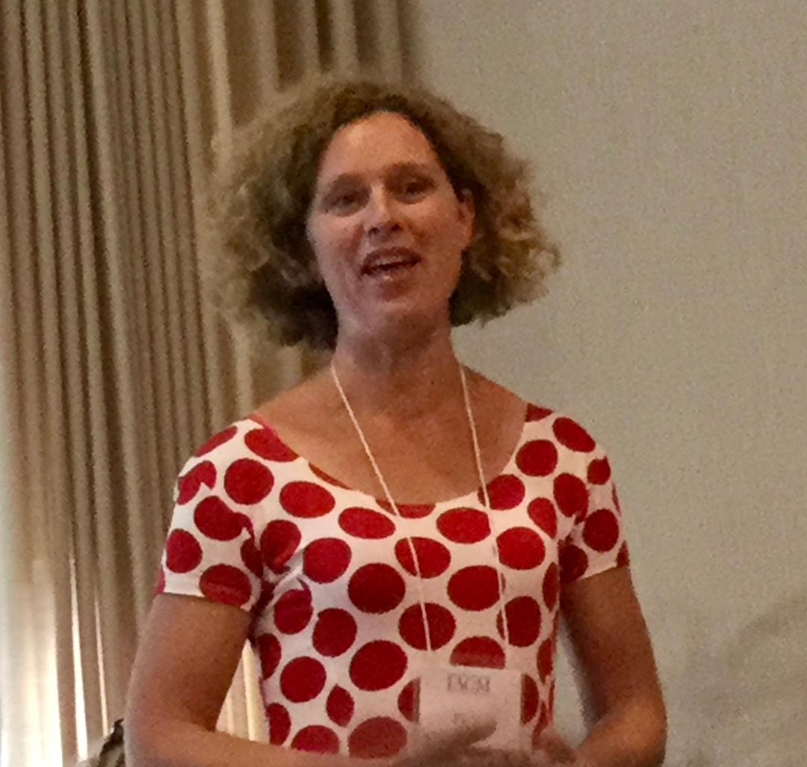
Fieke Harinck collaborator

Slide 33
Trust Matters
With Fieke Harinck 2022
In three experiments distrust of the opposing negotiator’s integrity leads to impasses
The effects of trust on outcomes is mediated by negotiator orientation as win-lose or problem-solving: manipulated distrust leads to a competitive win-lose orientation that reduces the acceptability of opponent offers
No main effects or interactions for mediator approach as direct, facilitative, or transformational
However, facilitative and transformational mediators were seen as being more helpful and influential irrespective of trust

Slide 34
Putting it All Together
Antecedents Concomitants Consequences
Preconditions
Negotiating objectives (1997,1999)
Process Dynamics
Flexibility (2004,2014,2021)
Emotions (2008)
Matching (2018)
PJ (2017)
Outcomes
Distributive justice (2017)
Integrative agreements (2019, 2021, 2022)
Context/Issues
Values/interests (2019)
Broader conflict (2017)
Situation
Other affirmation (2019)
Integrity trust (2022)
Mediation type (2019,2021)
Post Negotiation
Durable peace (2017)
Implementation of
Agreeementd (2017)

Slide 35
Paths from Objectives to Outcomes
Redistribution/interests -→ concession matching -→ distributive justice -→ unstable agreement
Innovation/values -→ PJ -→ integrity trust/other affirmation -→ integrative agreement -→ stable agreement/durable peace
Multilateral regime -→ PJ -→ transformational mediation -→ mixed distributive/integrative agreement -→ stable agreement

Slide 36
A GDN Odyssey: Contributions
. Empirical taxonomy for distinguishing types of international negotiation
. The robot effect on mediated outcomes
. Bringing emotions, justice, and trust into the GDN orbit
. The importance of attentiveness in generating turning points
. Interventions for dealing with value conflict
. A place for social science in the GDN world

Slide 37
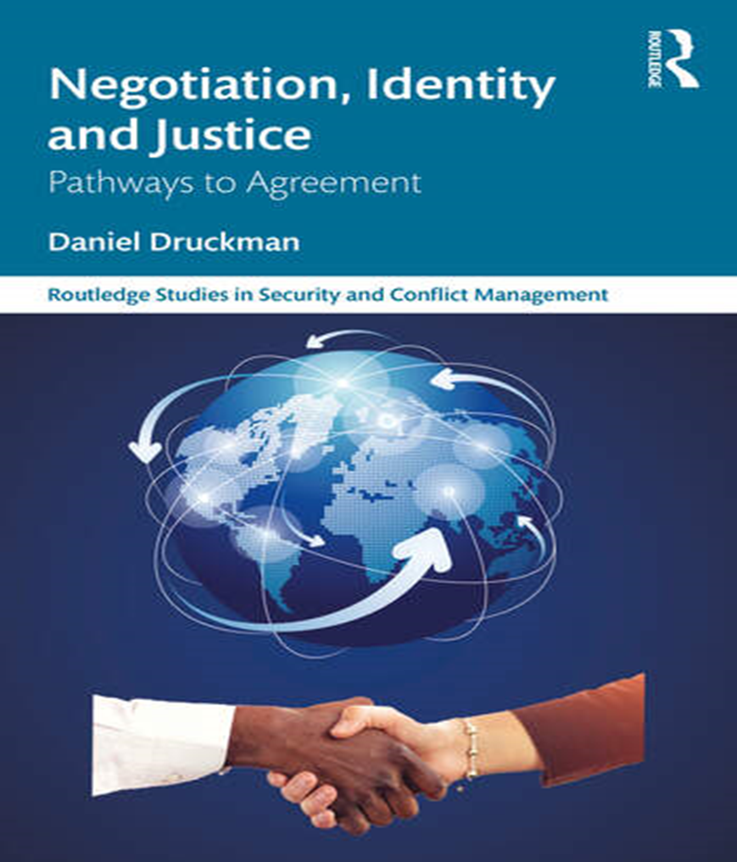
The Career

Slide 38
Thanks to the Movers and Shakers
Gregory, Mel, and Keith

Slide 39
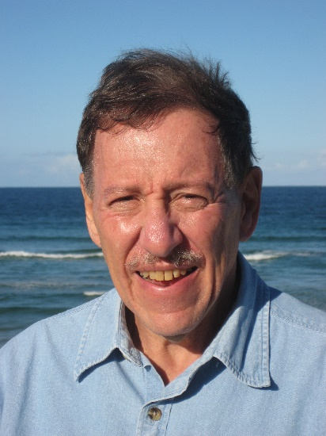
From Dan in Australia

